Slide 1









更多原创课件请关注【公众号/小红书/淘宝】：九七十四 【抖音/B站】：九七十四原创PPT课件 【微信】：asan97sss / mayday-9714
Showing, Not Telling
Ways of Describing Feelings
Reading for Writing

Slide 2

PPT下载 http://www.1ppt.com/xiazai/
Learning objectives:
By the end of the class, we will be able to:
1. figure out characters’ feelings through their actions;
2. understand what “showing” and “telling” are;
3. use “showing” in writing.

Slide 3
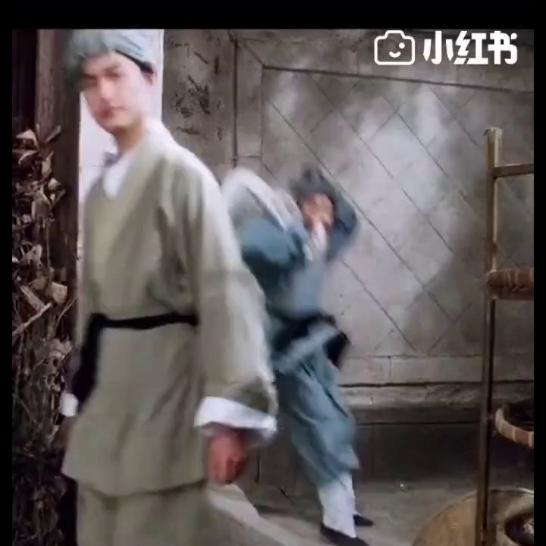
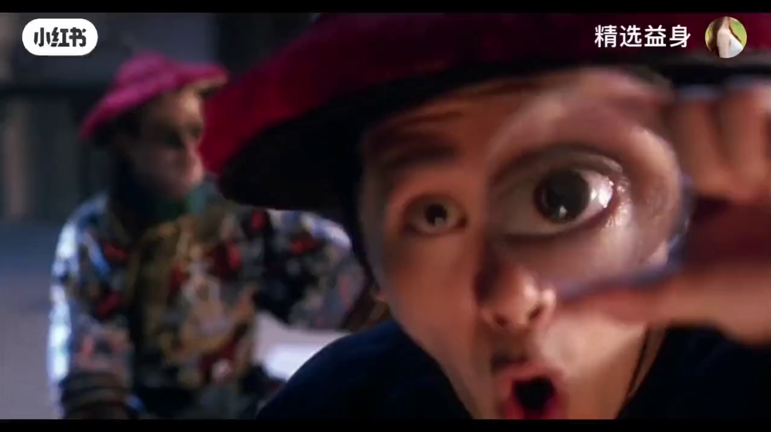
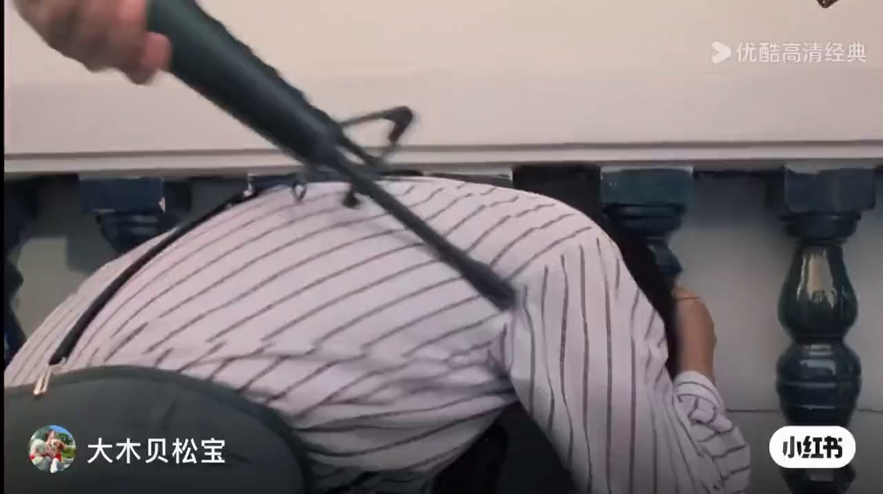
Motivating
Enabling
Assessing
He dances with joy, a big smile appearing on his face.
happy
His eyes widen and his mouth falls open in surprise.
surprised
His body shakes and he starts crying, with his hands around his head.
frightened
telling
showing

Slide 4
Motivating
Enabling
Assessing
Tick(√) “showing”
Feelings | Examples
excited | 1.He felt excited.
 | 2.He jumped up and down, with a big smile on his face.
body language
environment
jumped up and down
a big smile
√
During the test
bit her lip
nervous | 1.During the test, she bit her lip and looked at the clock many times.
 | 2.She was nervous.
looked at the clock
√
many times
frightened | 1.She felt frightened.
 | 2.She couldn’t move and her mouth opened widely in the dark room.
couldn’t move
her mouth opened widely
√
the dark room

Slide 5

Motivating
Enabling
Assessing
Which one is better?
Make a summary of “showing”
Showing, Not Telling is a writing skill. It means using details such as ______________ and ______________ to ______feelings instead of telling them directly. It makes your writing more vivid and specific.
01
02
body language
environment
Showing
or
Telling
VS.
show
vivid and specific

Slide 6
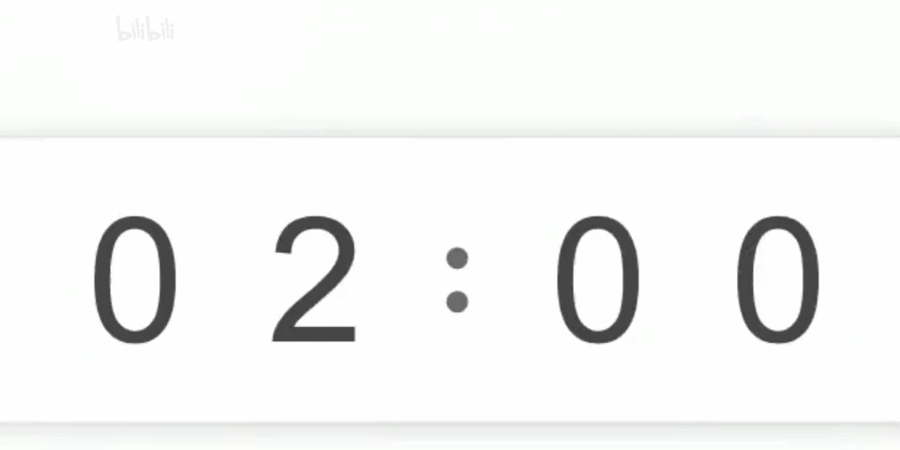
Motivating
Enabling
Assessing
Read for “showing” and feelings
had pictured it over and over again in my
Feelings
After I had pictured it over and over again in my mind, the big day finally arrived: my first day at senior high! I woke up early and rushed out of the door in my eagerness to get to know my new school.
...
“What?!” I tried to turn on my brain but the engine just wouldn’t start. “I should say my name, of course. But what else? What could I say to make a good first impression? Something about my insect collection, perhaps.” I was organising my words in my head when the girl next to me gave me a nudge. “It’s your turn!”
With butterflies in my stomach, I breathed deeply. “Hi, I’m Meng Hao.” Everyone started laughing. I looked at them in panic. “Nice to know we share the same name,” said my new teacher. I had been too nervous to pay attention when he introduced himself !... （节选自外研（2019）Book 1 Unit 1
mind
____________
woke up early
rushed out of the door
tried to turn on my brain but the engine just
wouldn’t start
excited
I was
nervous
organising my words in my head
____________
With butterflies in my stomach, I breathed deeply
looked at
them in panic
before going to school
during the English class

Slide 7
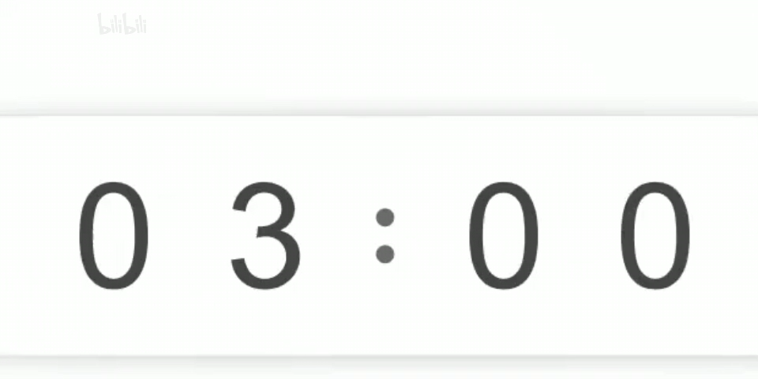
Motivating
Enabling
Assessing
Read for “showing” and feelings
While I was concentrating on photographing this amazing scene, I suddenly had a feeling that I was being watched. Slowly, and with the camera still held to my eye, I turned and froze. Only metres away from me was a bear. With water falling off its thick, brown hair, the bear stared back at me. Time stood still as the bear and I both waited to see who would move first. My legs started shaking. Somehow, I forced my finger to press the button. A second later, the bear turned and ran back into the forest. When I recovered from the shock, I looked at my camera. My most frightening but magical experience was now captured forever in a single image.（节选自外研（2019）Book 1 Unit 5
Feelings
was concentrating on
this amazing scene
____________
turned
froze
____________
relieved
Time stood still as
frightened
My legs started shaking
forced
____________
amazed
recovered from the shock
before the encounter
during the encounter
after the encounter

Slide 8
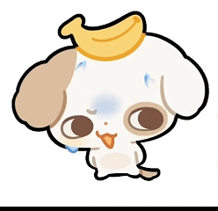
Motivating
Enabling
Assessing
Check and add more
醒得很早
excited | wake up early
 | rush out of the door
 | picture sth in one’s mind over and over again
 | dance with joy
frightened | freeze (froze, frozen)
 | ... start(s) shaking
 | Time stands still as...
 | with sweats falling down
 | with one’s eyes/mouth wide open
nervous | try to turn on one’s brain but the engine just wouldn’t start
 | With butterflies in one’s stomach, sb breath deeply...
 | look at ... in panic
 | say sth in a trembling（颤抖的） voice
 | bite one’s lip
 | Hands clench tightly...
努力开动脑筋，可脑子就是转不动
冲出门
在某人的脑海中一遍又一遍想象
某人深呼吸，心里七上八下...
呆住，僵住
惊慌地看着...
...开始颤抖
当...的时候，时间静止

Slide 9
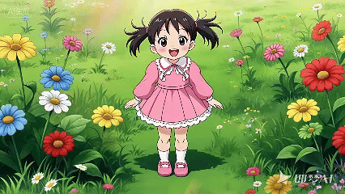
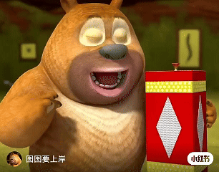
Motivating
Enabling
Assessing
Complete the sentences using “showing” or “telling”
excited
Telling: She was _________.
Telling: The bear was __________.
nervous
Showing: She _______________ , clapping her hands.
danced with joy
breathed deeply
Showing: The bear ______________, trying to calm down.

Slide 10
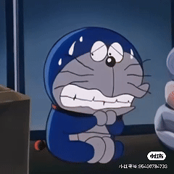
Motivating
Enabling
Assessing
Complete the sentences using “showing” or “telling”
Telling: The cat was ___________.
Showing: The body of the cat ______________ with ________ falling down.
frightened
was shaking
sweats

Slide 11
Motivating
Enabling
Assessing
Complete the paragraph using “showing”
I woke up early, having pictured the forest field trip over and over again. ________________________（心里紧张）, I rushed out of the door, joining my classmates who danced with joy—It felt like sweets were falling from the sky! Suddenly, a loud voice froze us all. ________________（当...的时候时间静止） a wild bear stepped out; we stared with mouths wide open, sweats falling down our faces. My hands _____________（握紧）, and my legs started to shake. I tried to think but my brain wouldn’t work. “Back away slowly!” Tom said _________________（用颤抖的声音）. I bit my lip, breathing deeply, as we moved away little by little—scary but truly unforgettable!
With butterflies in my stomach
Time stood still as
clenched tightly
in a trembling voice

Slide 12
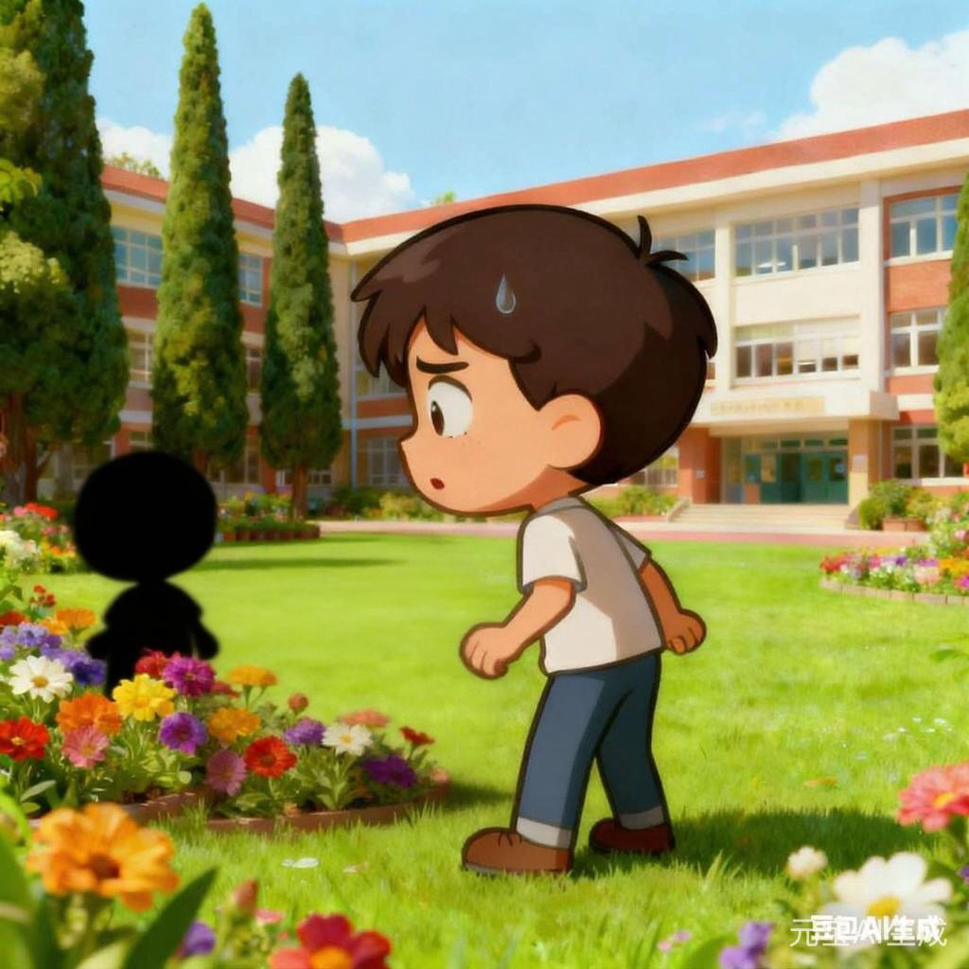
Motivating
Enabling
Assessing
Use “showing” to rewrite the sentence
Jack was frightened.
environment
Learning to write
To describe feelings vividly and specifically, add expressions of environment and body language.
in the campus garden
a black shadow
Time stood still as...
3. 当...的时候，时间静止
Time stood still as Jack saw a black shadow in the campus garden.

Slide 13
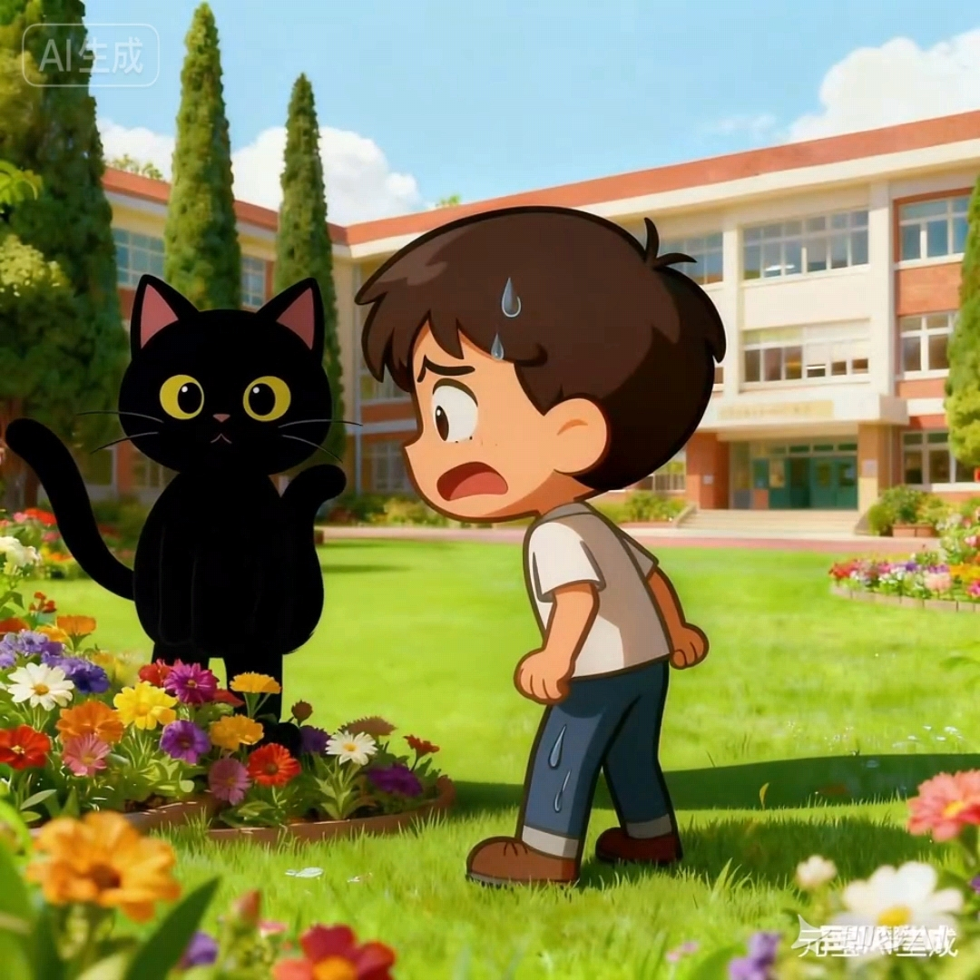
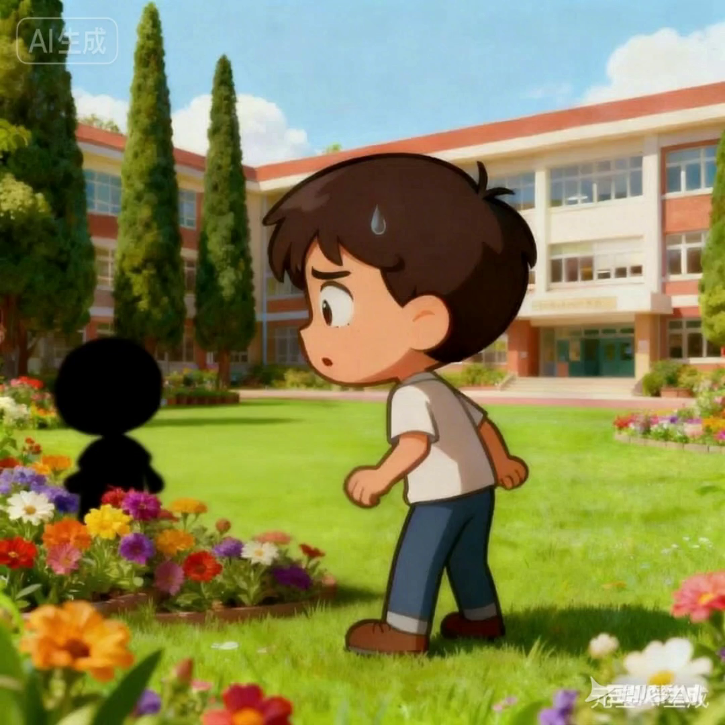
Motivating
Enabling
Assessing
Use “showing” to rewrite the sentence
Body language
Jack did sth, with sweats falling down.
sweats
with sweats falling down
Jack did sth, with his eyes and mouth wide open.
eyes
with his mouth and eyes wide open
mouth
hands
clenched tightly
His hands clenched tightly.
His legs started shaking.
legs
started shaking
body
froze
His body froze.

Slide 14
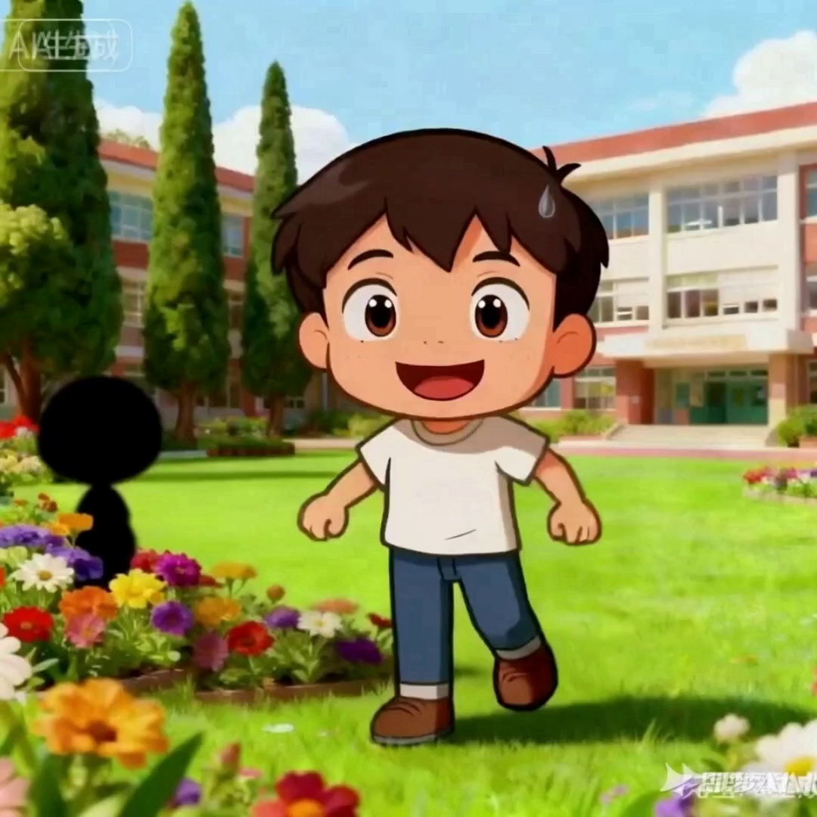
Motivating
Enabling
Assessing
Group Work:
Use “showing” to create a paragraph to describe the short video
Learning to write
①To describe feelings vividly and specifically, add expressions of environment and body language. ②To make your writing more logic, use connectives like at first; then; in the end and so on.
Learning to write
①To describe feelings vividly and specifically, add expressions of environment and body language. ②To make your writing more logic, use connectives like at first; then; in the end and so on.
Guidelines and Requirements
Connectives: Use proper connection words.
Vocabulary: Use vocabulary from today’s lesson.
Skill: Use “showing” in writing.

Slide 15
Motivating
Enabling
Assessing
Assess the writing
Assessment | Rating
Connectives: Use proper connection words.
Vocabulary: Use vocabulary from today’s lesson.
Skill: Use “showing” in writing.

Slide 16
One possible version:
On a sunny day, Jack was walking in the campus garden when he saw a black shadow. Time stood still as he saw it. At first, he froze. His legs started shaking and hands clenched tightly, with sweats falling down. Then, he said with his eyes and mouth wide open “What... what’s that?” In the end, it turned out to be a little cat, he sighed in relief.

Slide 17
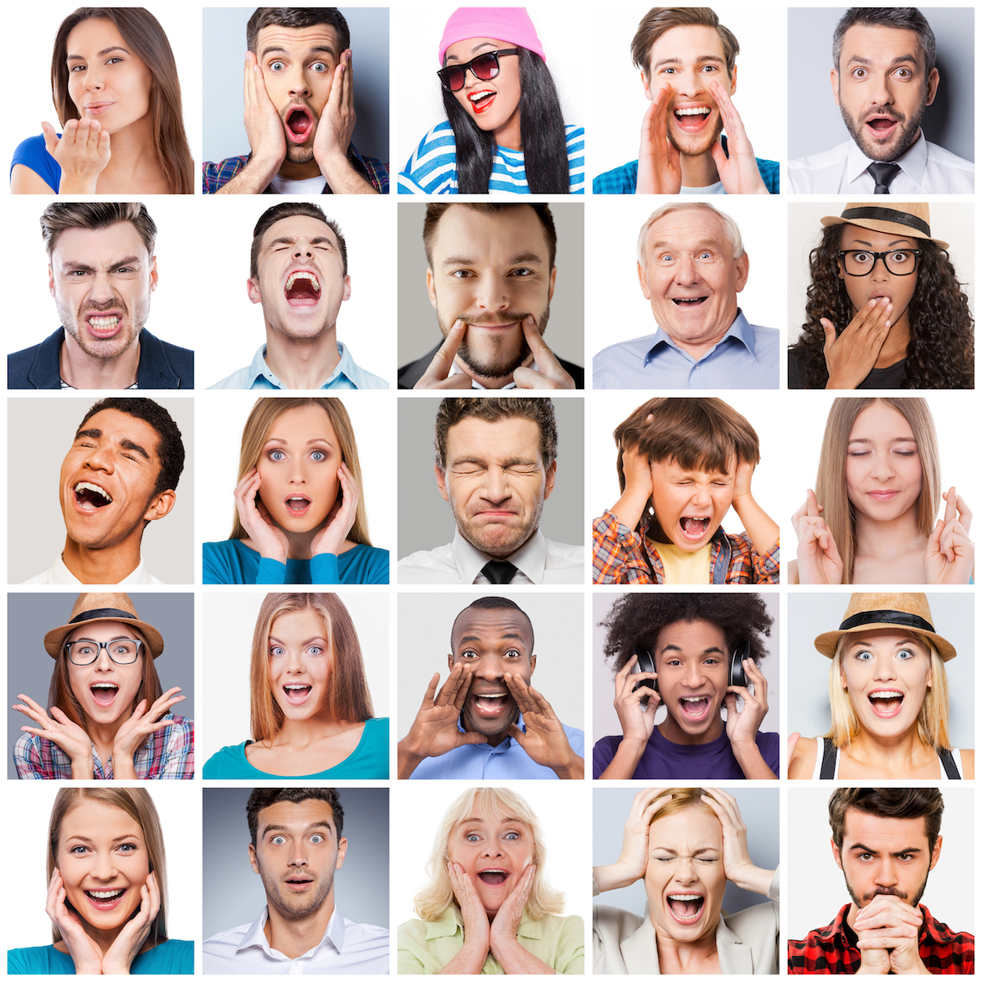
Deep-thinking
in writing
showing
Feelings
and
or
telling
in life
？
！

Slide 18

After this class, I can...
criteria
1. figure out characters’ feelings with their actions
2. understand what “showing” and “telling” are
3. use “showing” in writing

Slide 19
Assignments:
You need to do:
Polish your writing, using the skills of “Showing” and “Telling”.
You can choose to do:
Finish a task of continuation writing（2020浙江卷）.

Slide 20
T
h
a
n
k
s
Thank you！

